Slide 1
Data clustering – unsupervised approach
Purpose: separate the data into two clusters, where in each cluster, most of data come from a single source.

Slide 2
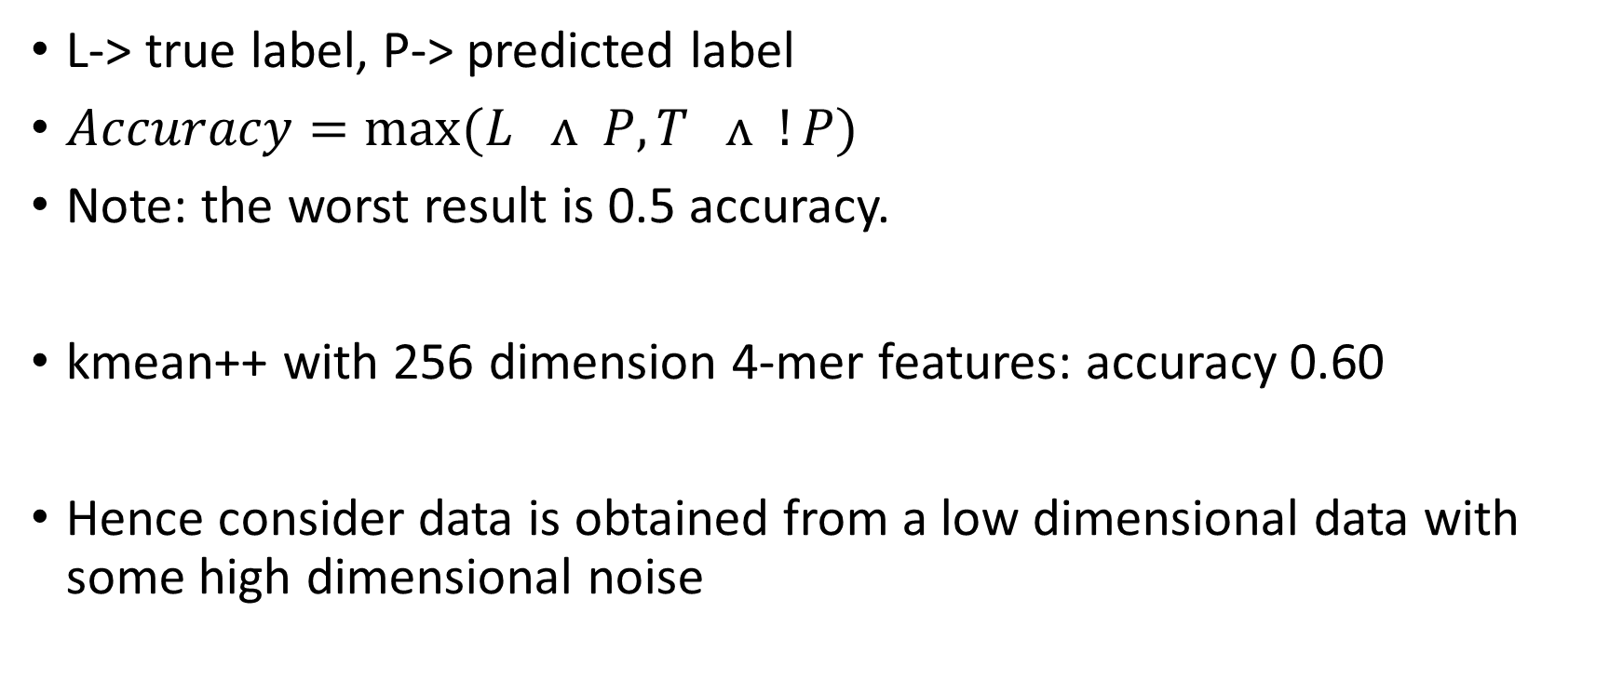
Metrics definition:
L-> true label, P-> predicted label
$Accuracy=max(L ʌ P, T ʌ !P)$
Note: the worst result is 0.5 accuracy.
kmean++ with 256 dimension 4-mer features: accuracy 0.60
Hence consider data is obtained from a low dimensional data with some high dimensional noise

Slide 3
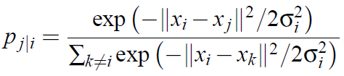

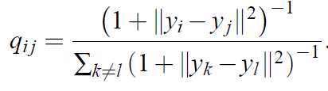

Dimension reduction
dimension reduction algorithm: to preserve as much of the important structure of the high dimension data within the low dimension data.
t-SNE: each single point has a distribution of potential neighbors on all other points, defined as Pj|i which translates as probability that j is I’s neighbor, which means each data has its internal view about all other points

Slide 4
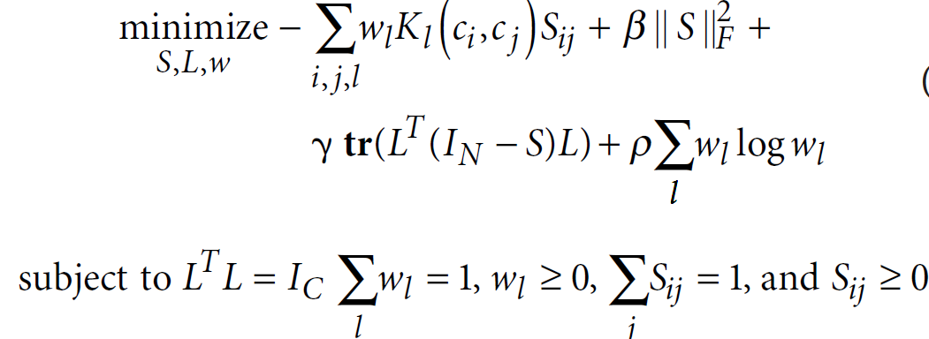

SIMLR
SIMLR is currently the state of the art dimension reduction technique. As the name implies, it uses multiple kernels to give the best estimate the dimension reduction result.
It tries to minimize the following cost function:
w is the weight vector for each kernel
L is a matrix to enforce the number of clusters (this result comes from spectral clustering theorem)
S is the similarity matrix

Slide 5
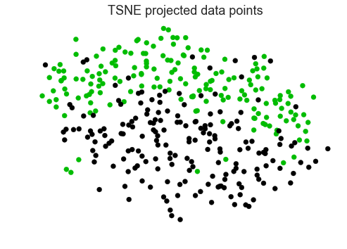
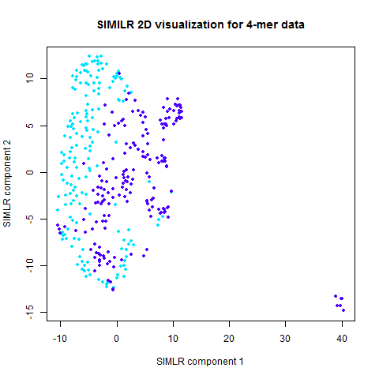
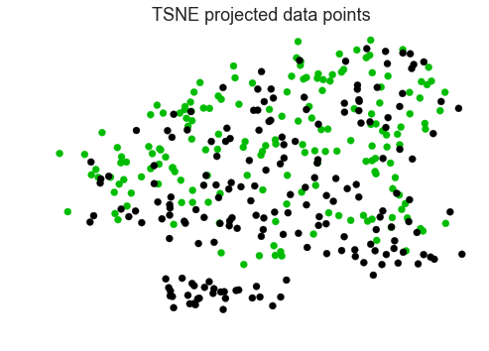
Reduction result
4-mer feature
Quality features
Good news is that there is internal structure in the data which makes clustering possible.

Slide 6
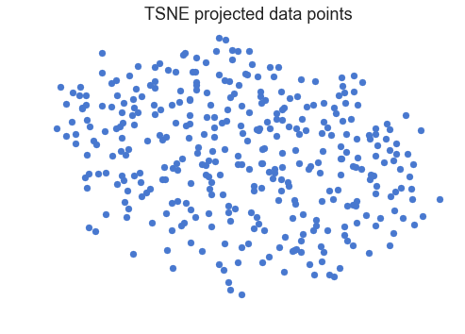
Problem analysis
we try to solve an easier problem, that given some points has known label, and the task is to classify another unlabeled node.
Say, we take a random sample, and able to know the data label by some Oracle.
This problem formulation is like the supervised learning framework, but the number of known data is not required to be many.

Slide 7
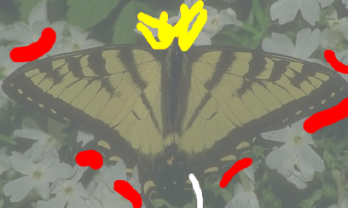
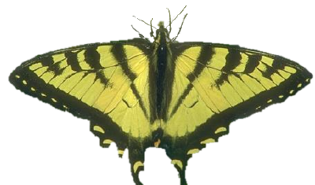
Two approaches:
Kmeans++
GraphCut : borrowed technique from image segmentation

Slide 8
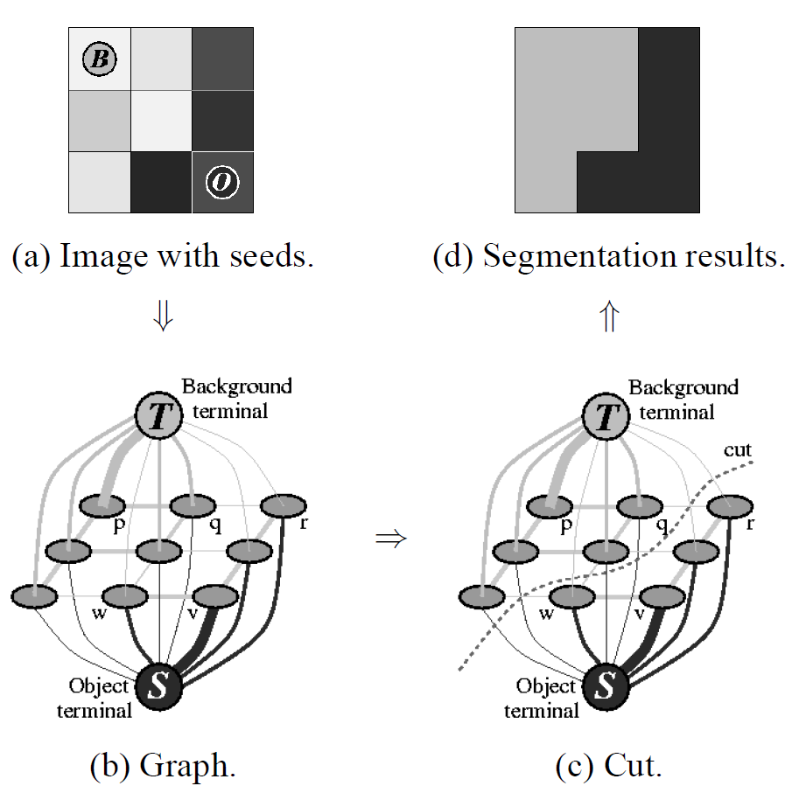
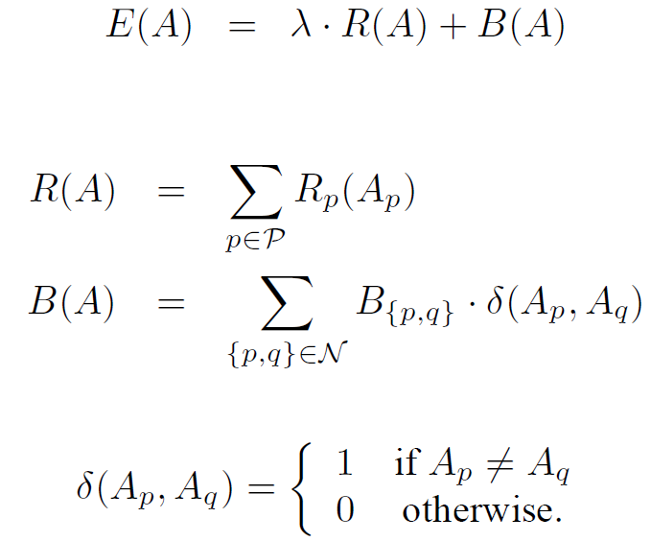
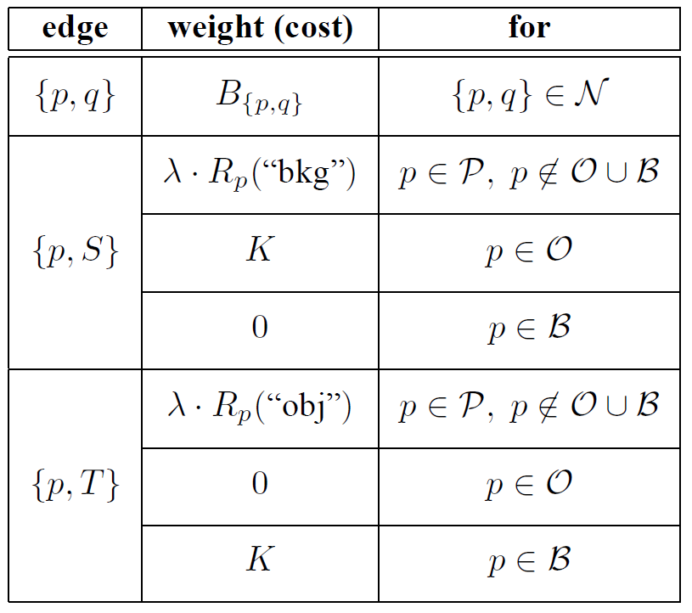
Graphcut
A : a vector with each element being a node, and the node is either an object or a background;
P : all pixels in an image
R : a metrics which measures the fitness of a node, P(p| object) or P(p| background)
B : a metrics which measures the similarity between nodes, usually defined by some kernel

Slide 9
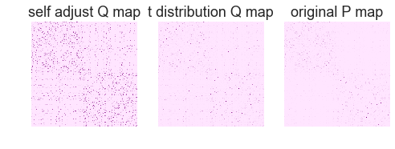
Reformulation
Define a fully connected graph first, with cost equal to neighbor probability learned using high dimensional data.
we only take highest 20 probable neighbor for each node.
Compute a 2d histogram with low dimension data using its x y location. (potential issue here)

Slide 10
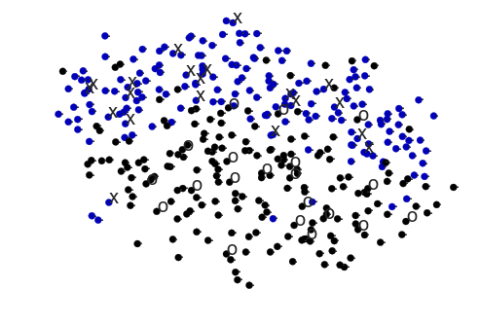
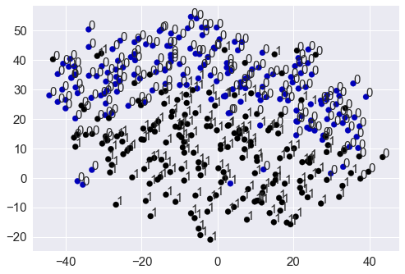
GraphCut
Benefit: there is a unique global optimal solution based on the cost function
Result: 0.877 accuracy

Slide 11
Kmeans
Accuracy: 84.7%
Advantage: susceptible to wrong label
 | Graphcut | Kmeans
0 mistake | 87.7% | 84.7%
1 mistake | 86.7% | 81%
2 mistake | 84.9% | 77%

Slide 12
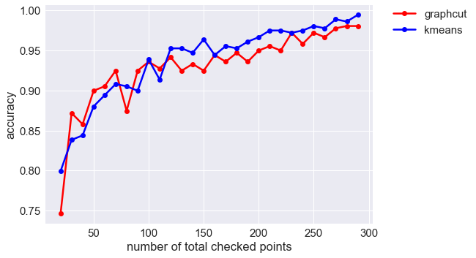
Accuracy as number of checked points

Slide 13
Evaluation
Why graphcut algorithm does not work well in this setting compared to its image segmentation setting?
Unlike image segmentation, edges are defined in a natural ways with its adjacent pixels.
In our setting, both edges weight and region weight come from high dimensional data. We equivalently use the data twice.

Slide 14
Future work
The graphcut algorithm generates a min-cut score which might be helpful to formalize a decision rule for choosing sampled points.
Ideally, the segmentation output with lower cost corresponds to a better initial settings

